Slide 1


Victoria Housing Price Prediction
Hatim M, John N, Saleha K, Pim A, Jasjeet K, Kaumudi M
Notes:
Our Dolphin Smart Team comprising with Hatim, John, Saleha,Jasjeet, Pim and myself,
The topic we selected is Victoria Housing Price prediction.

Slide 2
Project Scope & Objectives
Project Scope
The scope of this project is to create a website to predict housing prices of Victoria. The website created can be used by any buyer or an investor. We have used linear regression analysis to predict the outcome.
Data source :
API call from Domain.com.au to obtain property listing data.
LGA locality data from https://discover.data.vic.gov.au/dataset/victorian-electors-by-locality-postcode-and-electorates
We have extracted data from the above data sources, manipulated and transformed data using different tools to visualize and predict Victoria House pricing.
Notes:
Our team Dolphin Smart comprise with Hatim, John, Saleha,Jasjeet, Pim and myself,
The topic we selected for our final project is Victoria Housing Price prediction.
2.
API Calls were used to extract data to obtain property listing from Domain.Com
We also used government website vic.gov.au to extract Local Government Authority data.

Slide 3
Tools and Methods used
Extracting - API call
Clean the data - Python Pandas
Database creation - SQLAlchemy
Data Visualisation - Matplotlib/Seaborn/ Tableau
Machine Learning - Python with SkLearn, pickle, Flask
Development of Web - JS,CSS,HTML, Bootstrap library etc., were used.
Notes:
The team used API calls to extract data, Python Pandas to clean the data and SQLAlechemy to create the database.
For Data Visualisation we have used Matplotlib, Seaborn, and Tableau
Tools such as Python with Sklearn, pickle, Flask were used in machine learning
To develop the website, used JS, CSS, HTML, Bootstrap library etc.,
Initially we were to deploy our project in Herouku. However due to unavoidable circumstances we have now deployed our project via local machine.

Slide 4
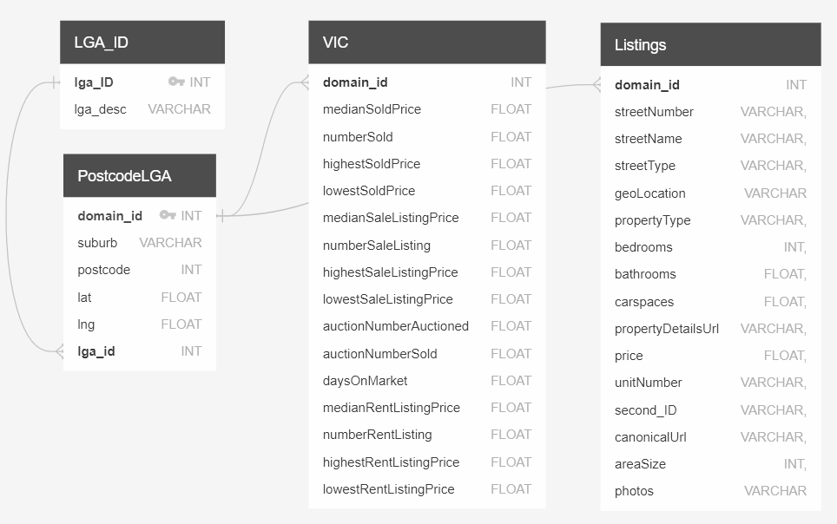
Data Modelling for PostgreSQL
Datasets
ERD - Diagram
LGA_ID - local government area and their unique identifier lga_id
PostcodeLGA - suburb, lga and unique domain_id
VIC - listed price, sold price, rent price etc. linked to domain_id
Listings - physical property address, property type and details linked to domain_id

Slide 5
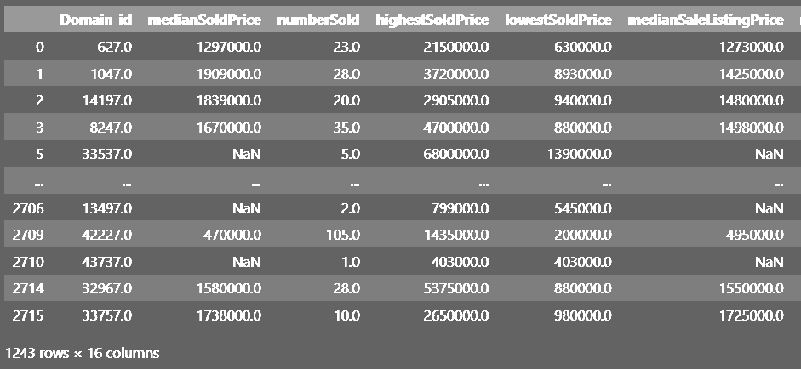
Data Transformation in Pandas
VIC dataset after data cleaning
Remove duplicates in datasets
VIC=VIC.drop_duplicates()
Drop ‘Not a Number’ values
VIC=VIC.dropna(subset=['a', 'b', 'c'], how= 'all')
Notes:
https://giphy.com/gifs/coxQHKASG60HrHtvkt

Slide 6
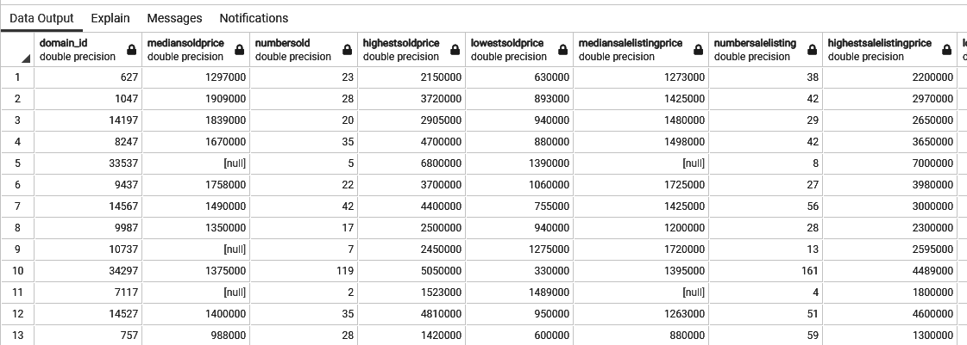
Data Loading in PostgreSQL
A single query file was generated to create and import data into database using -- PostgreSQL database dump
VIC dataset after loading into postgreSQL

Slide 7
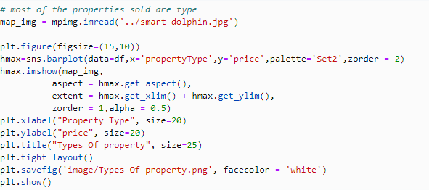
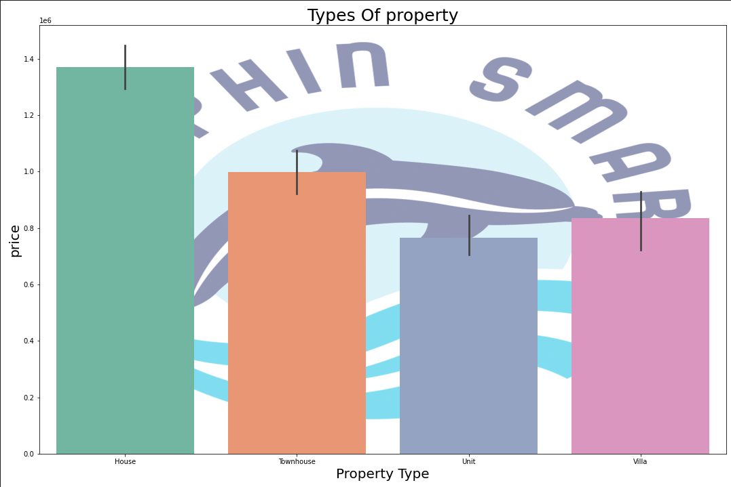
Data Visualization (Matplotlib)

Slide 8
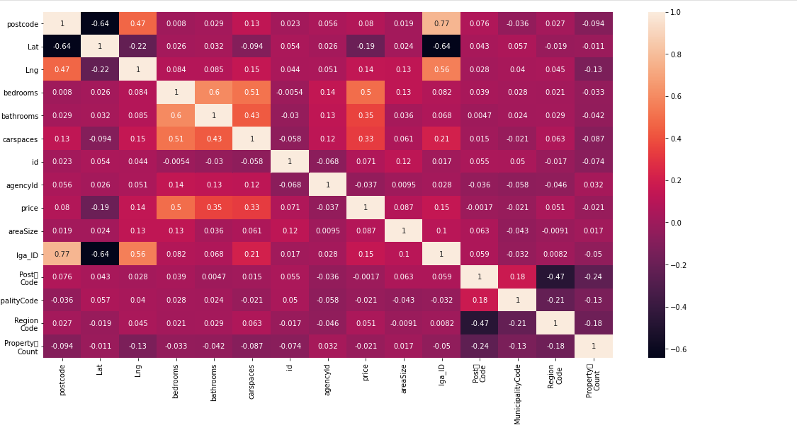
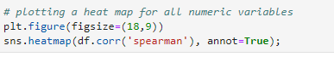
Data Visualization (Matplotlib)

Slide 9
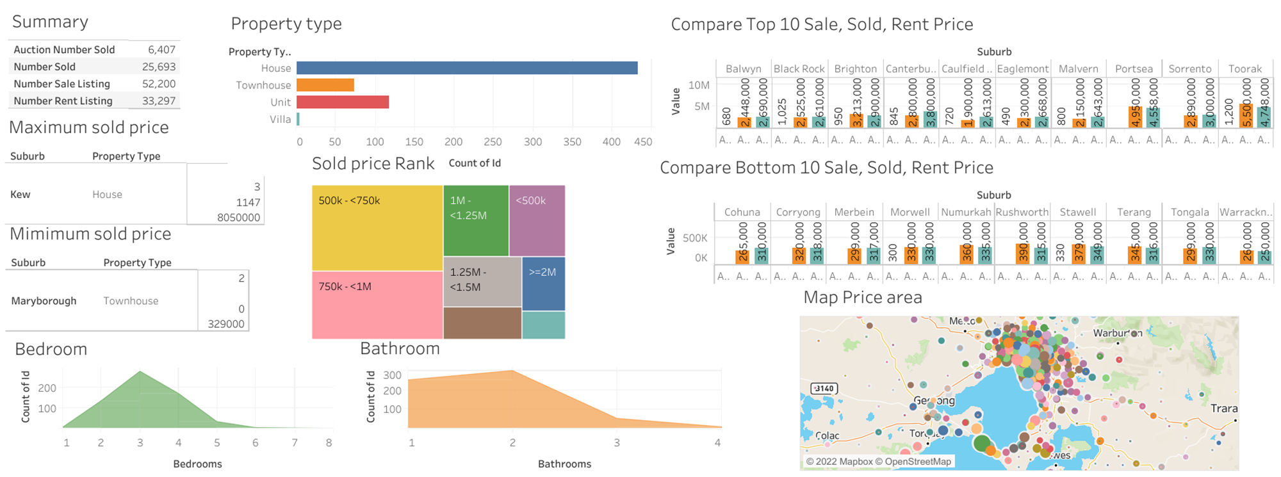
Data Visualisation (Tableau)

Slide 10

Over to you Hatim --------->

Slide 11


